Slide 1

Building a Retrieval-Augmented Generation (RAG) System for Open-Domain Question Answering
Presented By:
Yeswanth Labba
Nagasai Jaja
Sravanthi Kadari

Slide 2
Project Overview
Project Motivation: Open-domain question answering systems often struggle to accurately retrieve relevant context and provide precise answers. The Retrieval-Augmented Generation (RAG) model aims to improve this by combining retrieval-based methods with advanced language models.
Objective: The main goal of this project is to implement and evaluate a complete RAG pipeline capable of answering questions with high accuracy from a large open-domain knowledge base.

Slide 3
Dataset and Corpus Preparation
Data Source: Utilized the English Wikipedia dataset (wikipedia, 20220301.en version), accessible via streaming to avoid large downloads.
Subset Extraction: Extracted a manageable subset of approximately 5000 Wikipedia articles for efficiency and to ensure comprehensive coverage of diverse topics.
Paragraph Extraction Method: Split articles into paragraphs
Removed empty and excessively short or long paragraphs
Selected paragraphs containing between 20 and 200 words to ensure balanced context length
Final Corpus Statistics: Total paragraphs extracted: approximately 65,000

Slide 4
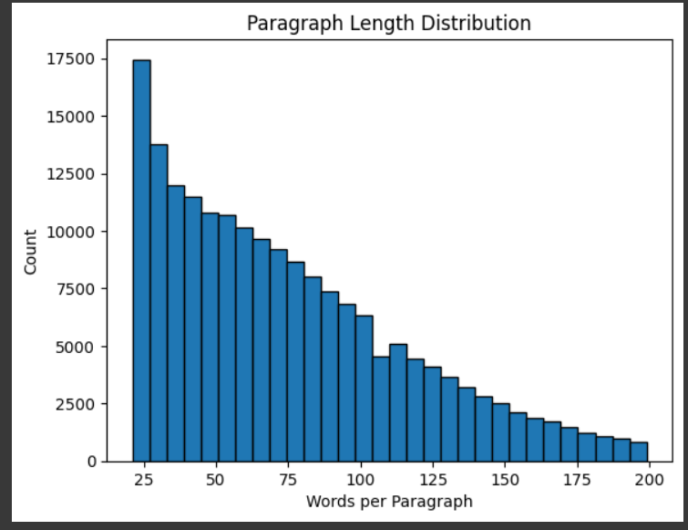
Analysis of Paragraph Length Distribution
Purpose of Analysis: Understanding the paragraph lengths is crucial as it influences both retrieval performance and embedding quality.
Observations: Majority paragraphs contain between 20 and 50 words, indicating concise yet informative contexts. Frequency decreases steadily as paragraph length increases beyond 100 words.
Significance: Shorter paragraphs generally yield more precise embedding vectors, enhancing retrieval accuracy and performance.

Slide 5
Embedding Generation & FAISS Indexing
Embedding Generation Technique: Generated semantic embeddings for each paragraph using a state-of-the-art transformer model (SentenceTransformer - all-MiniLM-L6-v2).
Embedding Details: Embeddings dimension: 384 dimensions
Total Embeddings created: ~65,000 vectors
Indexing Method (FAISS):
Used Facebook's FAISS (FlatL2) indexing for efficient similarity search.
Indexed embeddings allow rapid retrieval of contextually relevant paragraphs.

Slide 6

Extractive QA Evaluation Setup
Purpose of Evaluation: Evaluate the effectiveness and accuracy of multiple extractive question-answering models within our RAG pipeline.
QA Models Evaluated:
DeBERTa (Large): Known for superior contextual understanding and accuracy.
RoBERTa (Large): Optimized variant of BERT for robust textual representation.
BERT (Large, Whole Word Masking): Enhanced BERT variant for better handling complex queries.
Metrics for Evaluation:
Exact Match (EM): Percentage of answers exactly matching the ground truth.
F1 Score: Measures the overlap between predicted and actual answers, accounting for partial correctness.

Slide 7
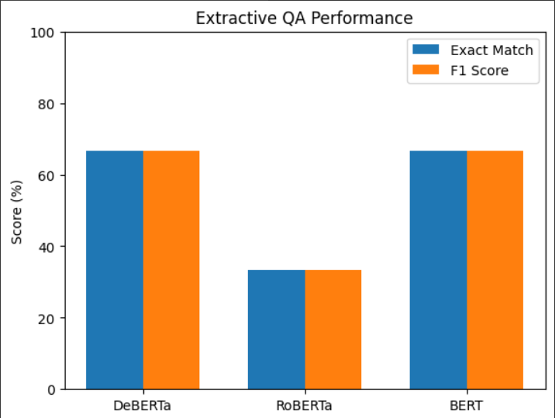
QA Model Performance Results
Key Observations:
DeBERTa and BERT significantly outperform RoBERTa.
Robust context retrieval leads to high-quality answers.
Model | Exact Match (%) | F1 Score (%) | Performance Summary
DeBERTa | 66.67% | 66.67% | Best overall performance; accurate and robust
RoBERTa | 33.33% | 33.33% | Lower accuracy; struggles with complex queries
BERT | 66.67% | 66.67% | Competitive performance; comparable to DeBERTa

Slide 8
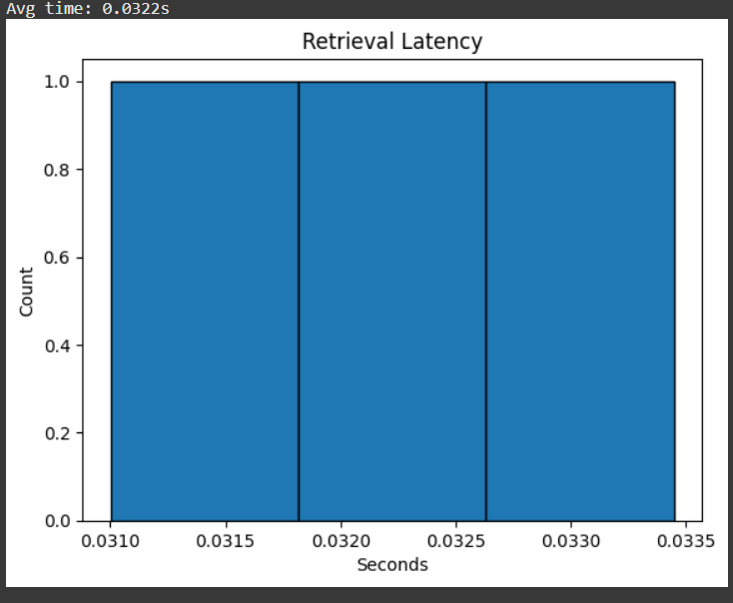
Retrieval Latency Analysis
Objective of Latency Profiling: Determine if the retrieval process is efficient enough for real-time or near real-time applications.
Profiling Method: Tested retrieval latency over multiple queries of varying complexity.
Results:
Average retrieval time per query: approximately 0.0322 seconds.
Consistent and fast retrieval ensures suitability for applications requiring rapid response times.
Practical Implication: The FAISS indexing system demonstrates excellent performance, making this approach practical for deployment in real-world scenarios.

Slide 9
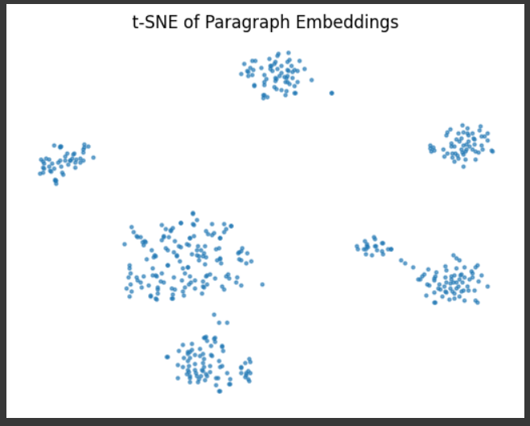
Embedding Space Visualization using t-SNE
Purpose of Visualization: Assess the quality of paragraph embeddings by visualizing semantic clustering and relationships.
Visualization Method (t-SNE):
Reduced high-dimensional embeddings into a 2-dimensional plot for easier interpretation.
Clear visual clusters represent semantically related paragraphs.
Insights Gained:
Embeddings form distinct semantic clusters.
High-quality embeddings indicate effective retrieval potential.

Slide 10
Conclusions & Key Insights
RAG significantly enhances QA accuracy through contextual retrieval combined with powerful transformer models.
DeBERTa and BERT demonstrate robust capabilities for open-domain QA tasks, clearly outperforming RoBERTa.
Efficient retrieval (FAISS indexing) indicates that this approach is highly scalable and practical for real-time applications.
Semantic embeddings effectively represent textual information, crucial for accurate context retrieval.

